Slide 1
Internet of Things
Introduction and Basic Concepts
Mehdi Rasti
Amirkabir University of Technology
spring-2020

Slide 2
Contents
Basic Concepts
Ecosystem
Things
Platform
Networks
Applications and Verticals
Architecture
Challenges
Business and Market Opportunities
Trends
Mostly adopted from IoT Fundamentals: Networking Technologies, Protocols, and Use Cases for the Internet of Thing, Cisco press, 2017

Slide 3
Contents
Basic Concepts
Ecosystem
Things
Platform
Networks
Applications and Verticals
Architecture
Challenges
Business and Market Opportunities
Trends

Slide 4
What is IoT?
"IoT" term was first introduced by Kevin Ashton in 1999.
Kevin Ashton:
If we had computers that knew everything there was to know about things—using data they gathered without any help from us—we would be able to track and count everything, and greatly reduce waste, loss and cost. We would know when things needed replacing, repairing or recalling, and whether they were fresh or past their best. We need to empower computers with their own means of gathering information, so they can see, hear and smell the world for themselves.
* Internet of Things Challenges, Advances, and Applications, CRC Press, 2018

Slide 5
What is IoT?
ITU-T, 2012
Internet of things (IoT): A global infrastructure for the information society, enabling advanced services by interconnecting (physical and virtual) things based on existing and evolving interoperable information and communication technologies.
* Internet of Things Challenges, Advances, and Applications, CRC Press, 2018
Notes:
NOTE 1 – Through the exploitation of identification, data capture, processing and communication capabilities, the IoT makes full use of things to offer services to all kinds of applications, whilst ensuring that security and privacy requirements are fulfilled.
NOTE 2 – From a broader perspective, the IoT can be perceived as a vision with technological and societal implications.

Slide 6
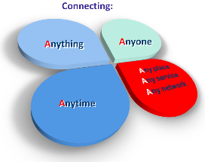
What is IoT?
IERC, 2014
A dynamic global network infrastructure with self-configuring capabilities based on standard and interoperable communication protocols where physical and virtual ‘things’ have identities, physical attributes, and virtual personalities and use intelligent interfaces, and are seamlessly integrated into the information network.
* Internet of Things Challenges, Advances, and Applications, CRC Press, 2018
* http://www.internet-of-things-research.eu/about_iot.htm

Slide 7
What is IoT?
ISO/IEC, 2015
An infrastructure of interconnected objects, people, systems, and information resources together with intelligent services to allow them to process information of the physical and the virtual world and react.
* Internet of Things Challenges, Advances, and Applications, CRC Press, 2018

Slide 8
What is IoT?
IEEE IoT, 2015
An IoT is a network that connects uniquely identifiable ‘Things’ to the Internet. Through the exploitation of unique identification and sensing, information about the ‘Thing’ can be collected and the state of the ‘Thing’ can be changed from anywhere, anytime, by anything.”
* Internet of Things Challenges, Advances, and Applications, CRC Press, 2018
Notes:
IEEE IoT, 2015
An IoT is a network that connects uniquely identifiable ‘Things’ to the Internet. The ‘Things’ have sensing/actuation and potential programmability capabilities. Through the exploitation of unique identification and sensing, information about the ‘Thing’ can be collected and the state of the ‘Thing’ can be changed from anywhere, anytime, by anything.”

Slide 9
What is IoT?
IoT is a world of interconnected things which are capable of sensing, actuating, and communicating among themselves and with the environment (i.e.,smart things or smart objects) while providing the ability to share information and act in parts autonomously to real/physical world events and by triggering processes and creating services with or without direct human intervention.
* Internet of Things A to Z : Technologies and Applications, IEEE Press, 2018

Slide 10
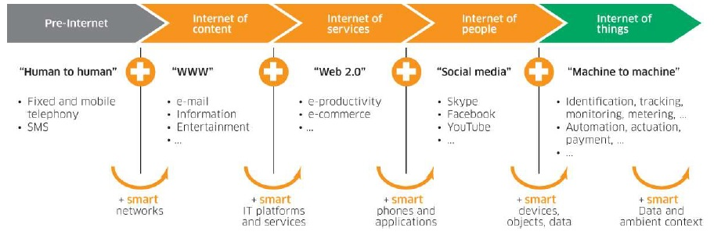
History of IoT
* Lecture, Internet of Things: An Introduction, Tecnico Ulisboa, 2018

Slide 11
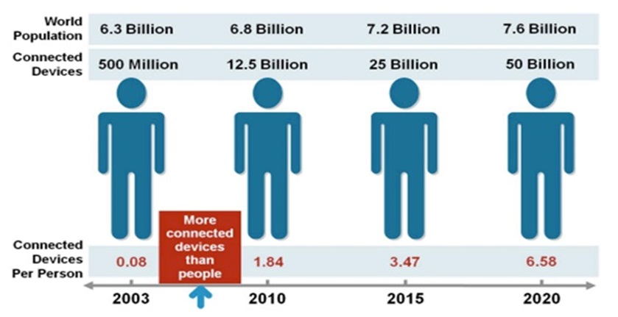

The number of connected devices:
Devices connected to the internet exceed the number of people
* http://blueapp.io/blog/a-brief-history-of-iot/
* Cisco IBSG, April 2011
Notes:
According to Cisco Internet Business Solutions Group (IBSG), the Internet of Things was born in between 2008 and 2009 at simply the point in time when more “things or objects” were connected to the Internet than people.
Citing the growth of smartphones, tablet PCs, etc the number of devices connected to the Internet was brought to 12.5 billion in 2010 (Related: see Kevin Kelly's One Machine), while the world’s human population increased to 6.8 billion, making the number of connected devices per person more than 1 (1.84 to be exact) for the first time in history.

Slide 12
IoT Impact
Growing the number of connected devices to 50 billion in 2020.
* IoT Fundamentals: Networking Technologies, Protocols, and Use Cases for the Internet of Thing, Cisco press, 2017

Slide 13
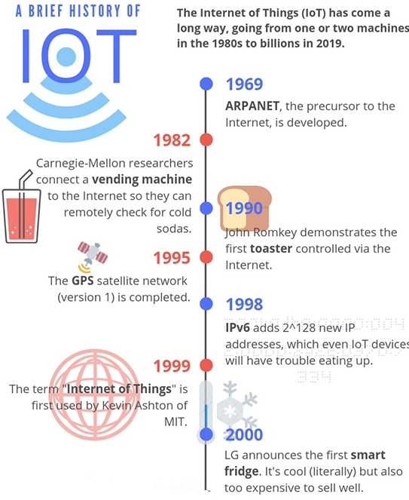
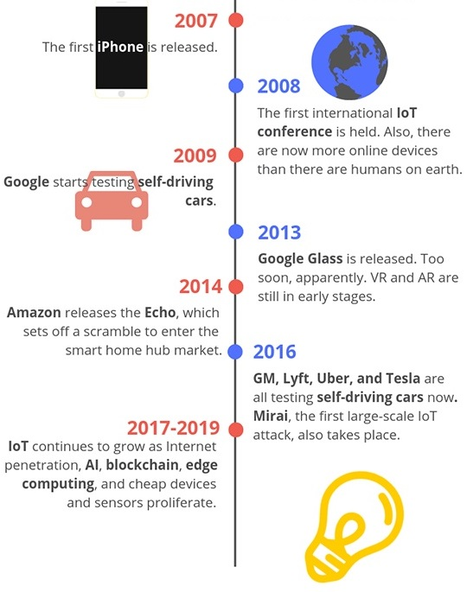
History of IoT
* https://www.iottechtrends.com/history-of-iot/
Notes:
1969: ARPANET, the precursor to the modern Internet, is developed and put into service by DARPA, the U.S Defense Advanced Research Projects agency. This is foundational to the “Internet” part of the Internet of Things.
1980s: ARPANET is opened up to the public by commercial providers, making it possible for people to connect things if they want to.
1982: Programmers at Carnegie Mellon University connect a Coca-Cola vending machine to the Internet, allowing them to check if the machine has cold sodas before going to purchase one. This is often cited as one of the first IoT devices.
1990: John Romkey, in response to a challenge, connected a toaster to the Internet and was able to successfully turn it on and off, bringing us even closer to what we think of as modern IoT devices.
1993: Engineers at the University of Cambridge, upholding the now well-established tradition of combining the Internet with appliances and food, develops a system that takes pictures of a coffee machine three times a minute, allowing its status to be remotely monitored by workers. World’s first webcam!
1995: The first version of the long-running GPS satellite program run by the U.S. government is finally completed, a big step towards proving one of the most vital components for many IoT devices: location.
1998: IPv6 becomes a draft standard, enabling more devices to connect to the internet than previously allowed by IPv4. While 32-bit IPv4 only provides enough unique identifiers for around 4.3 billion devices, 128-bit IPv6 has enough unique identifiers for up to 2^128, or 340 undecillion. (That’s 340 with 36 zeroes!)
1999: This is a big year for IoT, since it’s when the phrase was probably first used. Kevin Ashton, the head of MIT’s Auto-ID labs, included it in a presentation to Proctor & Gamble executives as a way to illustrate the potential of RFID tracking technology.
2000: LG announces what has become one of the quintessential IoT devices: the Internet refrigerator. It was an interesting idea, complete with screens and trackers to help you keep track of what you had in your fridge, but its $20,000+ USD price tag didn’t earn it a lot of love from consumers.
2004: The phrase “Internet of Things” starts popping up in book titles and makes scattered media appearances.
2007: The first iPhone appears on the scene, offering a whole new way for the general public to interact with the world and Internet-connected devices.
2008: The first international IoT conference is held in Zurich, Switzerland. The year is fitting, since it’s also the first year that the number of Internet-connected devices grew to surpass the number of humans on earth.
2009: Google starts self-driving car tests, and St. Jude Medical Center releases Internet-connected pacemakers. St. Jude’s device will go on to make yet more history by being the first IoT medical device to suffer a major security breach in 2016 (without casualties, fortunately). Also, Bitcoin starts operation, a precursor to blockchain technologies that are likely to be a big part of IoT.
2010: The Chinese government names IoT as a key technology and announces that it is part of their long-term development plan. In the same year Nest releases a smart thermostat that learns your habits and adjusts your home’s temperature automatically, putting the “smart home” concept in the spotlight.
2011: Market research firm Gartner adds IoT to their “hype cycle,” which is a graph used to measure the popularity of a technology versus its actual usefulness over time. As of 2018, IoT was just coming off of the peak of inflated expectations and may be headed for a reality check in the trough of disillusionment before ultimately hitting the plateau of productivity.
2013: Google Glass is released – a revolutionary step in IoT and wearable technology but possibly ahead of its time. It flops pretty hard.
2014: Amazon releases the Echo, paving the way for a rush into the smart home hub market. In other news, an Industrial IoT standards consortium form demonstrates the potential for IoT to change the way any number of manufacturing and supply chain processes work.
2016: General Motors, Lyft, Tesla, and Uber are all testing self-driving cars. Unfortunately, the first massive IoT malware attack is also confirmed, with the Mirai botnet assaulting IoT devices with manufacturer-default logins, taking them over, and using them to DDoS popular websites.
2017-2019: IoT development gets cheaper, easier, and more broadly-accepted, leading to small waves of innovation all over the industry. Self-driving cars continue to improve, blockchains and AI begin to be integrated into IoT platforms, and increased smartphone/broadband penetration continues to make IoT an attractive proposition for the future.

Slide 14
Contents
Basic Concepts and History
Ecosystem
Things
Platform
Networks
Applications and Verticals
Architecture
Challenges
Business and Market Opportunities
Trends

Slide 15
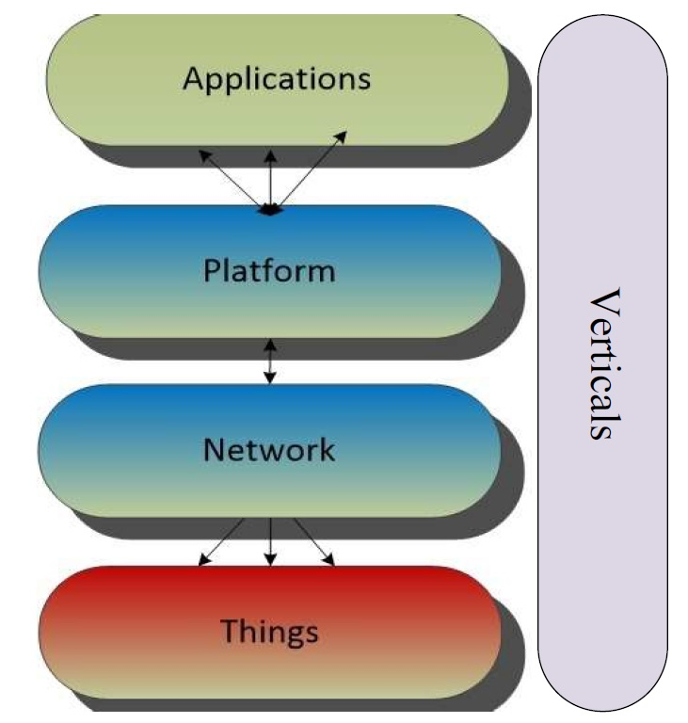
IoT Ecosystem
Things:
sensors and actuators
Network:
communication technologies
Platform:
security, process modeling and device management, data stream and information management, integration of information access mechanisms
Applications:
making decisions, data analytics

Slide 16
Contents
Basic Concepts and History
Ecosystem
Things
Networks
Platform
Applications and Verticals
Architecture
Challenges
Business and Market Opportunities
Trends

Slide 17
What are Things?
Smart objects or Things are any physical objects that contain embedded technology to sense and/or interact with their environment in a meaningful way by being interconnected and enabling communication among themselves or an external agent.
Things are
Sensors
Actuators
* IoT Fundamentals: Networking Technologies, Protocols, and Use Cases for the Internet of Thing, Cisco press, 2017
Notes:
A thing is a physical object in which a processor, data storage system, sensor system, and network technology are embedded.
Some things can also affect their environment by means of actuators.
Most things have a user interface and interaction capabilities to communicate with the environment or other devices.
The capability of things to communicate with other things and with their environment is a core component of IoT.
* Internet of Things A to Z : Technologies and Applications, IEEE Press, 2018

Slide 18
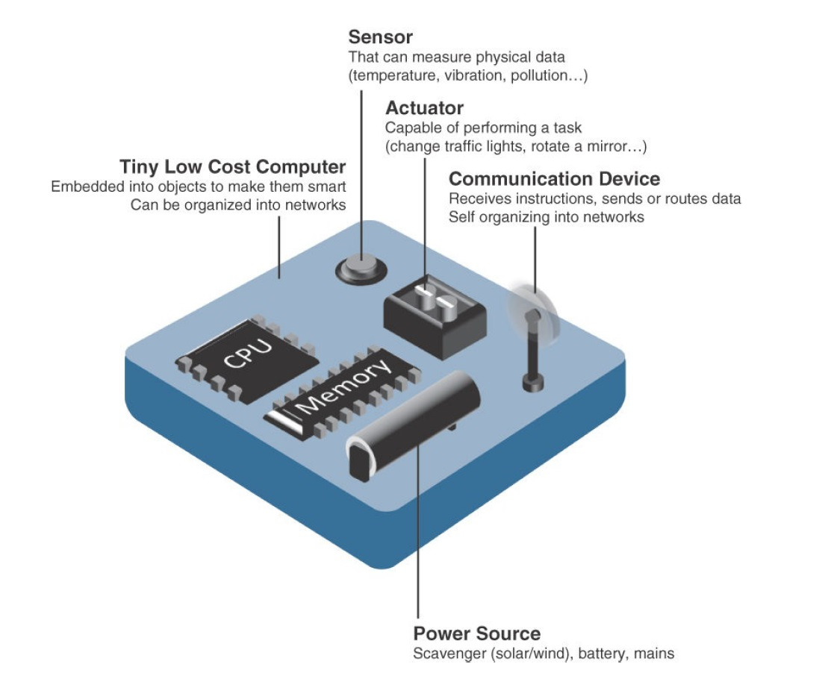
What are Things?
Sensors
Actuators
* IoT Fundamentals: Networking Technologies, Protocols, and Use Cases for the Internet of Thing, Cisco press, 2017
Notes:
A smart object is a device that has, at a minimum, the following four defining characteristics :
Processing unit: A smart object has some type of processing unit for acquiring data, processing and analyzing sensing information received by the sensor(s), coordinating control signals to any actuators, and controlling a variety of functions on the smart object, including the communication and power systems. The specific type of processing unit that is used can vary greatly, depending on the specific processing needs of different applications. The most common is a microcontroller because of its small form factor, flexibility, programming simplicity, ubiquity, low power consumption, and low cost.
Sensor(s) and/or actuator(s): A smart object is capable of interacting with the physical world through sensors and actuators. A sensor learns and measures its environment, whereas an actuator is able to produce some change in the physical world. A smart object does not need to contain both sensors and actuators. In fact, a smart object can contain one or multiple sensors and/or actuators, depending upon the application.
Communication device: The communication unit is responsible for connecting a smart object with other smart objects and the outside world (via the network). Communication devices for smart objects can be either wired or wireless. Overwhelmingly, in IoT networks smart objects are wirelessly interconnected for a number of reasons, including cost, limited infrastructure availability, and ease of deployment. There are myriad different communication protocols for smart objects.
Power source: Smart objects have components that need to be powered. Interestingly, the most significant power consumption usually comes from the communication unit of a smart object. As with the other three smart object building blocks, the power requirements also vary greatly from application to application. Typically, smart objects are limited in power, are deployed for a very long time, and are not easily accessible. This combination, especially when the smart object relies on battery power, implies that power efficiency, judicious power management, sleep modes, ultra-low power consumption hardware, and so on are critical design elements. For long-term deployments where smart objects are, for all practical purposes, inaccessible, power is commonly obtained from scavenger sources (solar, piezoelectric, and so on) or is obtained in a hybridized manner, also tapping into infrastructure power.

Slide 19
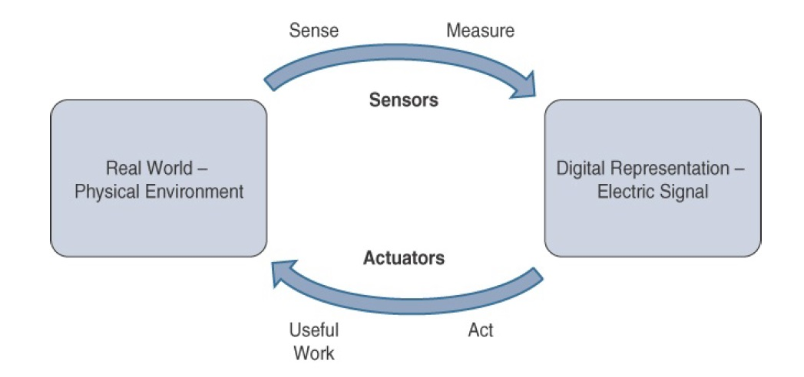
What are Things?
How Sensors and Actuators Interact with the Physical World
* IoT Fundamentals: Networking Technologies, Protocols, and Use Cases for the Internet of Thing, Cisco press, 2017
Notes:
Sensors are designed to sense and measure practically any measurable variable in the physical world. They convert their measurements (typically analog) into electric signals or digital representations that can be consumed by an intelligent agent (a device or a human).
Actuators, on the others hand, receive some type of control signal (commonly an electric signal or digital command) that triggers a physical effect, usually some type of motion, force, and so on.

Slide 20
What are Things?
Comparison of Sensors and Actuators Functionality with Humans

Slide 21
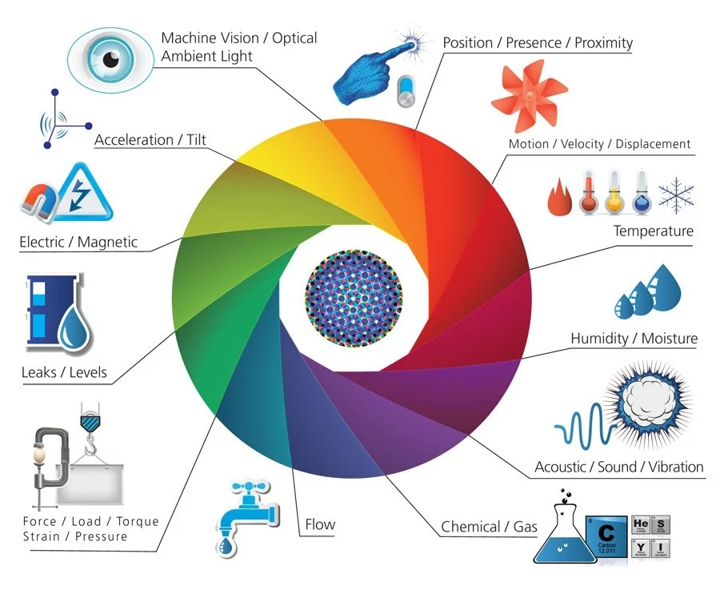
What are Things?
Sensors and Actuators
* https://www.postscapes.com/iot-sensors-actuators

Slide 22
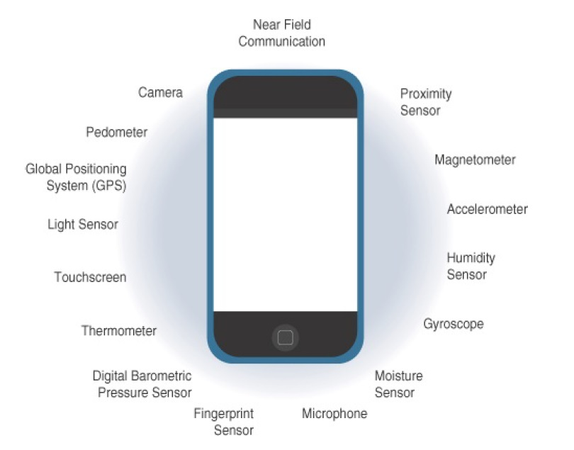
What are Things?
Sensors in smart phones
* IoT Fundamentals: Networking Technologies, Protocols, and Use Cases for the Internet of Thing, Cisco press, 2017
Notes:
حسگر «شتاب‌سنج» (Accelerometer) یکی از ابزارهای درون گوشی هوشمند است که اجازه می‌دهد این گجت، جهت حرکت را در محورهای مختلف تشخیص بدهد. این حسگر در ردیاب‌های سلامتی هم یافت می‌شود. شمارش قدم‌های کاربر در گوشی، توسط همین شتاب‌سنج‌ها صورت می‌گیرد؛ بدون این‌که نیازی به خرید گجت پوشیدنی جداگانه باشد. همچنین این حسگر جهت قرارگیری گوشی را به نرم‌افزار اطلاع می‌دهد؛ این قابلیت به‌خصوص بعد از ظهور اپ‌های واقعیت افزوده از اهمیت خیلی زیادی برخوردار شده است.
همان‌طور که از نام شتاب‌سنج مشخص است، این حسگر شتاب را اندازه‌گیری می‌کند تا به‌طور مثال در هنگام حرکت، نقشه‌ی اسنپ‌چت بتواند آواتار کاربر را در یک ماشین روی نقشه قرار دهد. علاوه بر این استفاده‌ی مفرح، شتاب‌سنج در انواع و اقسام برنامه‌ها به کار گرفته می‌شود. خود این حسگر از حسگرهای دیگری ازجمله ساختارهای کریستالی میکروسکوپی تشکیل شده است که براثر نیروهای شتاب‌دهنده تحت فشار قرار می‌گیرند. سپس شتاب‌سنج، ولتاژهای برآمده از کریستال‌ها را تفسیر می‌کند تا بتواند سرعت گوشی و جهت آن را تشخیص دهد. از تغییر جهت دادن اپ‌ها از حالت عمودی به افقی گرفته تا نمایش سرعت در هنگام رانندگی، شتاب‌سنج کارکردهای زیادی در گوشی دارد و به همین خاطر، شتاب‌سنج را می‌توان از مهم‌ترین حسگرهای گوشی به‌حساب آورد.
‌
«ژیروسکوپ» (Gyroscope) برای درک جهت قرارگیری گوشی به شتاب‌سنج کمک می‌کند. این حسگر دقت گوشی را بالاتر می‌برد تا مثلا عکس‌های ۳۶۰ درجه تا حد ممکن زیبا و جذاب شوند. هر وقت که مشغول یک بازی رانندگی با موبایلتان هستید و برای کنترل فرمان جهت گوشی را تغییر می‌دهید، به‌جای شتاب‌سنج، این ژیروسکوپ است که وارد عمل می‌شود. به این دلیل که فقط تکان‌های کوچکی به گوشی داده می‌شود و گجت واقعا حرکتی در فضا ندارد.
منبع:
https://www.digikala.com/mag/%D8%AD%D8%B3%DA%AF%D8%B1-%DA%AF%D9%88%D8%B4%DB%8C-%D9%87%D9%88%D8%B4%D9%85%D9%86%D8%AF-%DA%86%DA%AF%D9%88%D9%86%D9%87-%DA%A9%D8%A7%D8%B1-%D9%85%DB%8C%E2%80%8C%DA%A9%D9%86%D8%AF/

Slide 23
Sensors
Measures some physical quantity and converts it into a digital representation.
That digital representation is typically passed to another device for transformation into useful data that can be consumed by intelligent devices or humans.
Sensors can be readily embedded in any physical objects that are easily connected to the Internet by wired or wireless networks.
Because these connected host physical objects with multidimensional sensing capabilities communicate with each other and external systems, they can interpret their environment and make intelligent decisions.
* IoT Fundamentals: Networking Technologies, Protocols, and Use Cases for the Internet of Thing, Cisco press, 2017
Notes:
Sensors
A sensor measures some physical quantity and converts that measurement reading into a digital representation.
That digital representation is typically passed to another device for transformation into useful data that can be consumed by intelligent devices or humans.
Sensors can be readily embedded in any physical objects that are easily connected to the Internet by wired or wireless networks.
Because these connected host physical objects with multidimensional sensing capabilities communicate with each other and external systems, they can interpret their environment and make intelligent decisions.

Slide 24
Sensors
Different types of sensors
Active or passive
Invasive or non-invasive
Contact or no-contact
Absolute or relative
Area of application
How sensors measure
What sensors measure
* IoT Fundamentals: Networking Technologies, Protocols, and Use Cases for the Internet of Thing, Cisco press, 2017
Notes:
Sensors
Different types of sensors
Active or passive: Sensors can be categorized based on whether they produce an energy output and typically require an external power supply (active) or whether they simply receive energy and typically require no external power supply (passive).
Invasive or non-invasive: Sensors can be categorized based on whether a sensor is part of the environment it is measuring (invasive) or external to it (non-invasive).
Contact or no-contact: Sensors can be categorized based on whether they require physical contact with what they are measuring (contact) or not (no-contact).
Absolute or relative: Sensors can be categorized based on whether they measure on an absolute scale (absolute) or based on a difference with a fixed or variable reference value (relative).
Area of application: Sensors can be categorized based on the specific industry or vertical where they are being used.
How sensors measure: Sensors can be categorized based on the physical mechanism used to measure sensory input (for example, thermoelectric, electrochemical, piezoresistive, optic, electric, fluid mechanic, photoelastic).
What sensors measure: Sensors can be categorized based on their applications or what physical variables they measure.

Slide 25
Sensors
Example of Sensor Applications Based on Mobility and Throughput
* IoT Fundamentals: Networking Technologies, Protocols, and Use Cases for the Internet of Thing, Cisco press, 2017
Notes:
Sensors
Different types of sensors
Active or passive: Sensors can be categorized based on whether they produce an energy output and typically require an external power supply (active) or whether they simply receive energy and typically require no external power supply (passive).
Invasive or non-invasive: Sensors can be categorized based on whether a sensor is part of the environment it is measuring (invasive) or external to it (non-invasive).
Contact or no-contact: Sensors can be categorized based on whether they require physical contact with what they are measuring (contact) or not (no-contact).
Absolute or relative: Sensors can be categorized based on whether they measure on an absolute scale (absolute) or based on a difference with a fixed or variable reference value (relative).
Area of application: Sensors can be categorized based on the specific industry or vertical where they are being used.
How sensors measure: Sensors can be categorized based on the physical mechanism used to measure sensory input (for example, thermoelectric, electrochemical, piezoresistive, optic, electric, fluid mechanic, photoelastic).
What sensors measure: Sensors can be categorized based on their applications or what physical variables they measure.

Slide 26
Actuators
Actuators receive some type of control signal (commonly an electric signal or digital command) that triggers a physical effect, usually some type of motion, force, and so on.
* IoT Fundamentals: Networking Technologies, Protocols, and Use Cases for the Internet of Thing, Cisco press, 2017

Slide 27
Actuators
Different types of actuators
Type of motion
Power
Binary or continuous
Area of application
Type of energy
* IoT Fundamentals: Networking Technologies, Protocols, and Use Cases for the Internet of Thing, Cisco press, 2017
Notes:
Actuators
Different types of actuators
Type of motion: Actuators can be classified based on the type of motion they produce (for example, linear, rotary, one/two/three-axes).
Power: Actuators can be classified based on their power output (for example, high power, low power, micro power)
Binary or continuous: Actuators can be classified based on the number of stable-state outputs.
Area of application: Actuators can be classified based on the specific industry or vertical where they are used.
Type of energy: Actuators can be classified based on their energy type.

Slide 28
Contents
Basic Concepts and History
Ecosystem
Things
Networks
Platform
Applications and Verticals
Architecture
Challenges
Business and Market Opportunities
Trends

Slide 29
IoT Networks
Having determined the the smart object and its required transmission capabilities (transmission range, data volume and frequency, sensor density and mobility), you are ready to connect the object and communicate.
A first step in designing an IoT network is to examine the requirements in terms of mobility and data transmission (how much data, how often, how long, how much power).
IoT Network is the communication domain for the IoT devices and endpoints.
It includes the devices themselves and the communications network that links them.
* IoT Fundamentals: Networking Technologies, Protocols, and Use Cases for the Internet of Thing, Cisco press, 2017

Slide 30
Access Technologies and Distances

Slide 31
Comparison Between Common Last-Mile Technologies inTerms of Range Versus Cost, Power, and Bandwidth

Slide 32
Contents
Basic Concepts and History
Ecosystem
Things
Networks
Platform
Applications and Verticals
Architecture
Challenges
Business and Market Opportunities
Trends

Slide 33
IoT Platforms
IoT platforms are the central piece in the Internet of Things architecture that connect the real and the virtual worlds and enable communication between objects.
In its most simple form, an IoT platform is just about enabling connectivity between objects.
In a more sophisticated form, the platform consists of a variety of important building blocks:
Connectivity and normalization,
device management,
database,
processing and action management,
analytics,
visualization,
additional tools, and
external interfaces
* IoT Platforms, IoT Analytics, 2015
Notes:
CONNECTIVITY and NORMALIZATION
Every IoT platform starts with a connectivity layer. It has the function of bringing different protocols and different data formats into one “software” interface. This is necessary in order to ensure all devices can be interacted with and data is read correctly. Having all device data in one place and in one format is the basic necessity to monitor, manage, and analyze IoT devices. What sounds fairly simple can be a nightmare from the point of view of a computer engineer. Libraries need to be set up for individual devices so that something as basic as an industrial pressure sensor that sends analogue signals can be integrated into the platform for one use case while a wearable device or the data from someone’s smartphone can be integrated for another use case. Advanced devices usually provide an API that allows for a standardized communication interface to the platform. However, very often so-called software agents have to be developed and installed on the hardware in order to enable the IoT platform to establish a stable connection.
2. DEVICE MANAGEMENT
The device management module of an IoT platform ensures the connected objects are working properly and its software and applications are updated and running. Tasks performed in this module include device provisioning, remote configuration, management of firmware/ software updates, and troubleshooting. As thousands or even millions of different devices become part of an IoT enabled solution, bulk-actions, and automation are essential to control costs and reduce manual labor.
3. DATABASE
Data storage is a central piece in an IoT platform. The management of device data brings the requirements for databases to a new level:
• Volume. The amount of data that needs to be stored can be massive. In many IoT solutions only the minority of the generated data can be stored.
• Variety. Different devices and different sensor types produce very different forms of data.
• Velocity. Many IoT cases require the analysis of streaming data to make instant decisions.
• Veracity. In some instances, sensors produce ambiguous and inaccurate data. An IoT platform therefore usually comes with a cloud based database solution that is distributed across different sensor nodes. It should be scalable for big data and should be able to store both structured (SQL) and unstructured data (NoSQL).
4. PROCESSING & ACTION MANAGEMENT
The data that is captured in the connectivity & normalization module and that is stored in the database gets brought to life in this part of the IoT platform. A rule-based event-action-trigger allows performance of “smart” actions based on specific sensor data. In a smart home, for instance, an event-action-trigger can be defined so that all lights get turned off when a person leaves the house. The technical realization often comes in the form of an If-this-then-that rule (IFTTT): If the GPS signal indicates Jason’s smartphone is more than 5 yards away from his house, then turn off all the lights in his house.
5. ANALYTICS
Many IoT use cases go beyond action-management and require complex analytics to get the most out of the IoT data-stream. In a smart home, for example, the analytics engine can provide the algorithms that allow the IoT platform to learn which combination of lights and heating are preferred by the user at what time of the day and in relation to the outside weather conditions..The analytics engine encompasses all dynamic calculations of sensor data, from basic data clustering to deep machine learning.
6. DATA VISUALIZATION
Sometimes also referred to as “visual analytics,” data visualization presents a much-underrated part of the IoT platform. The combination of human eye and brain is still far superior to most analytic and rule-based engines. That is why data visualization is so important: it enables humans to see patterns and observe trends. Visualization comes in the form of line-, stacked-, or pie charts, 2D- or even 3D-models. The visualization dashboard that is available to the manager of the IoT platform is often also included in the prototyping tools that an advanced IoT platform provides.
7. ADDITIONAL TOOLS
Advanced IoT platforms often offer an additional set of tools for the developer and the manager of the IoT solution. Development tools allow the IoT developer to prototype and test the IoT case. Sometimes even in the form of what-you-see-is-what-you-get-editors (WYSIWYG) that lets you create simple smartphone apps for visualizing and controlling connected devices. Management-focused tools support the daily operations of the IoT solution. An example is an „access management“ tool that determines who has access to which device and to which data. Another tool is “reporting”, that allows for data export (e.g., in a.csv or.json format) as well as data queries and other forms of structured output.
8. EXTERNAL INTERFACES
IoT enabled businesses are rarely built standalone and on a green field. In established companies it is crucial that the Internet of Things integrates with existing ERP systems, management tools, manufacturing execution systems and the rest of the wider IT-ecosystem.

Slide 34
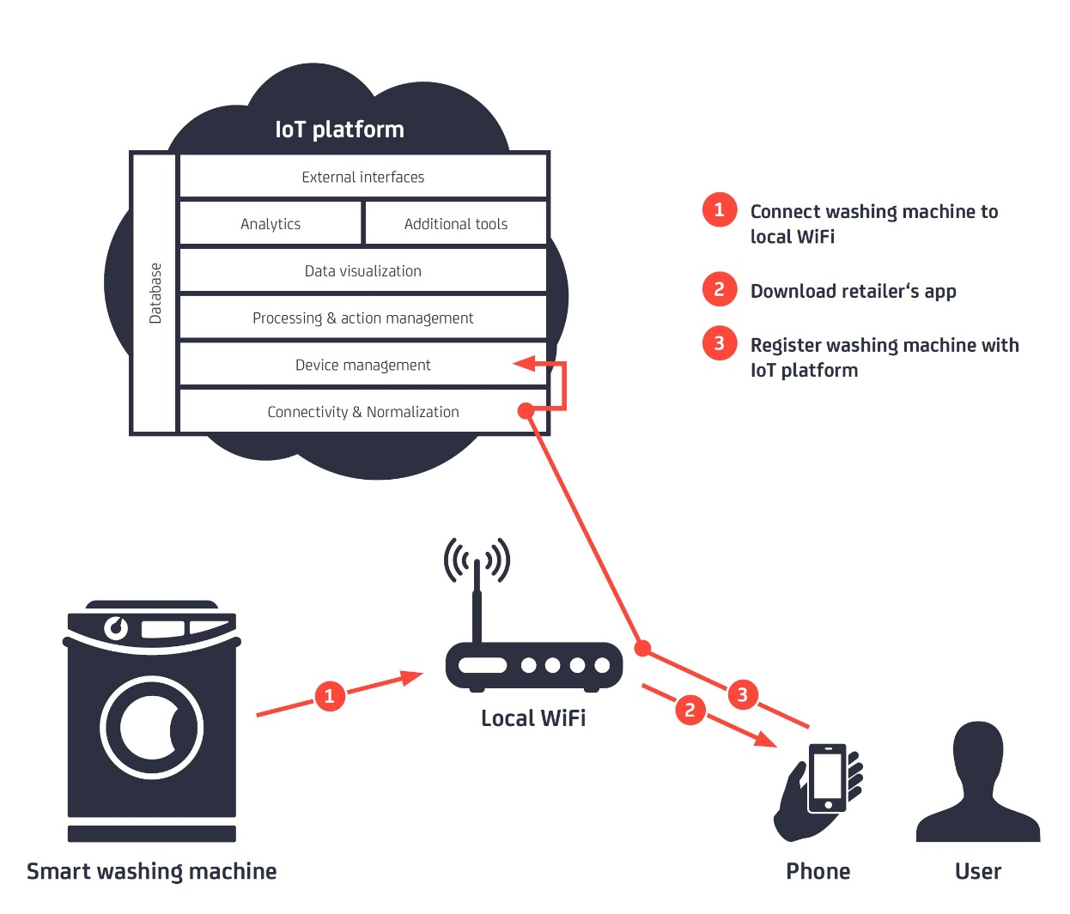
IoT Platforms
* IoT Platforms, IoT Analytics, 2015

Slide 35
IoT Platforms
An IoT platform is an end-to-end software framework.
It's the glue that pulls together information from sensors, devices, networks, and software that work together to unlock valuable, actionable data.
A platform should have the ability to:
manage devices
allow remote connections to all relevant objects or devices
collect and manage data and help you define business rules
enable analytics and visualization
integrate with IT and cloud services
* https://www.business.att.com/learn/research-reports/whats-an-iot-platform-and-what-role-does-it-play.html

Slide 36
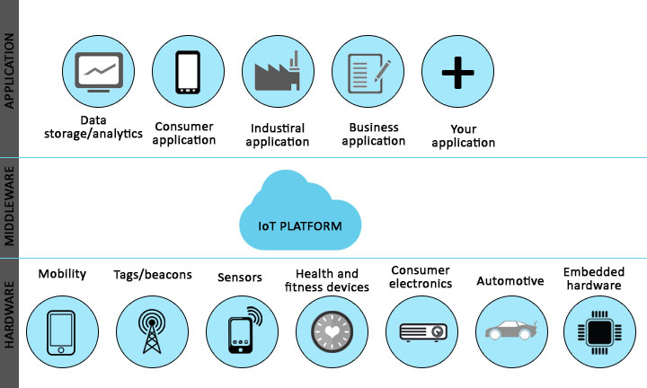
IoT Platforms
* https://www.educba.com/iot-platform/

Slide 37
Contents
Basic Concepts and History
Ecosystem
Things
Platform
Networks
Applications and Verticals
Architecture
Challenges
Business and Market Opportunities
Trends

Slide 38
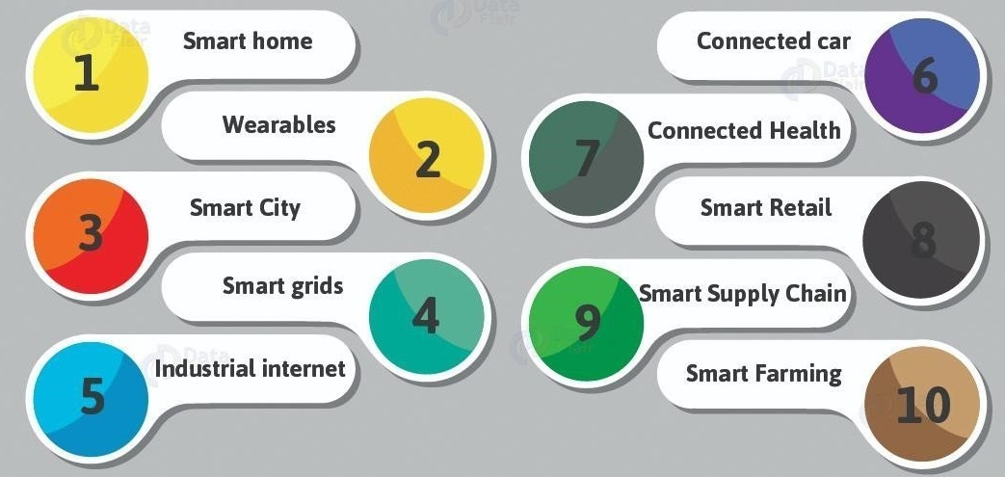
IoT Applications and Verticals
* https://www.meee-services.com/category/artificial-intelligence/

Slide 39
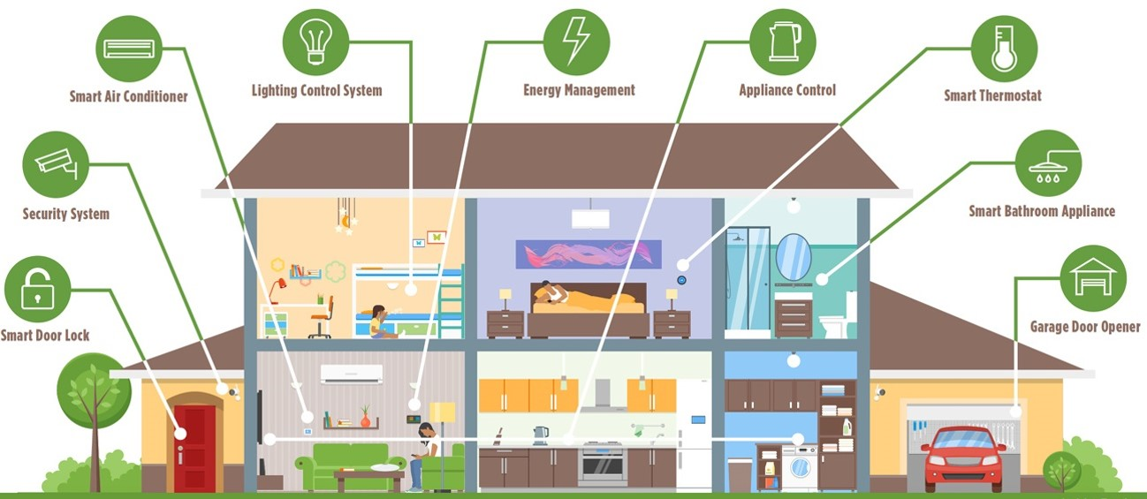
IoT Applications and Verticals- Smart Home
Smart Home
* https://www.bluebonnetelectric.coop/Community/News/articles/2016/Magazine-Stories/HOME,-SMART-HOME-Trends-in-residential-technology

Slide 40
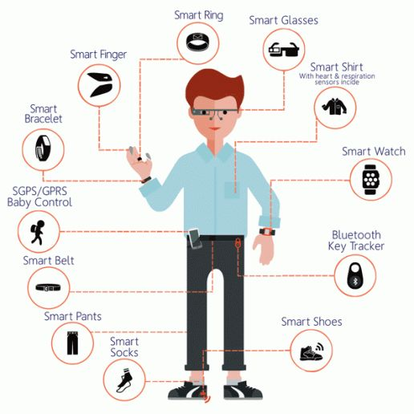
IoT Applications and Verticals- Smart Wearables
* https://www.quora.com/Why-the-boom-of-wearable-devices

Slide 41
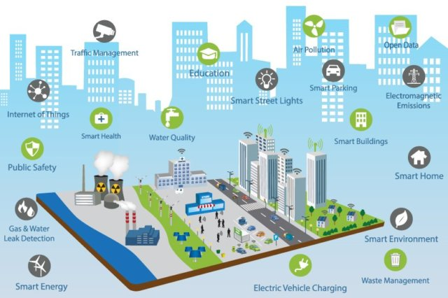
IoT Applications and Verticals- Smart City
Smart City
* https://www.ifpenergiesnouvelles.com/article/smart-city-energy-challenges-facing-sustainable-cities

Slide 42
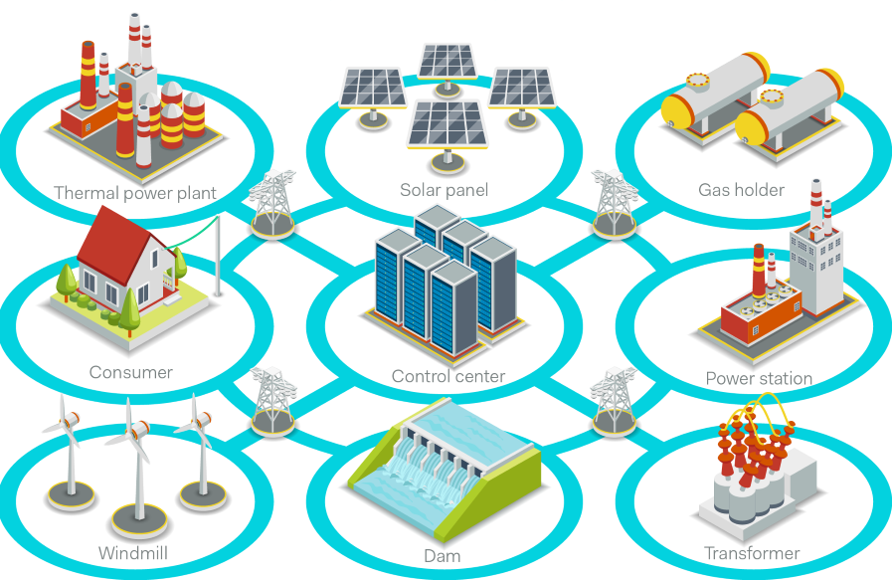
IoT Applications and Verticals- Smart Grid
* https://www.powerelectronicsnews.com/technology/is-your-smart-grid-secured

Slide 43
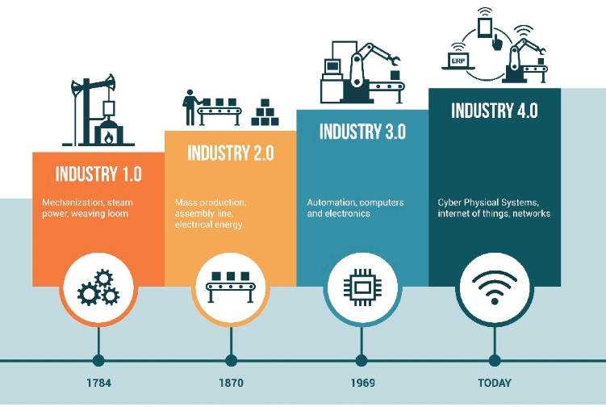
IoT Applications and Verticals- Industrial IoT
* https://www.seekmomentum.com/blog/page/3

Slide 44
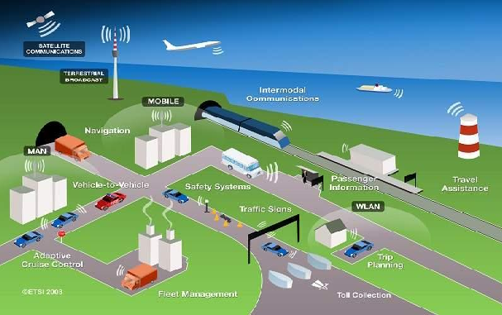
IoT Applications and Verticals- Smart Transportation
* https://www.sentinelassam.com/editorial/intelligent-transportation-system-and-smart-city-4/

Slide 45
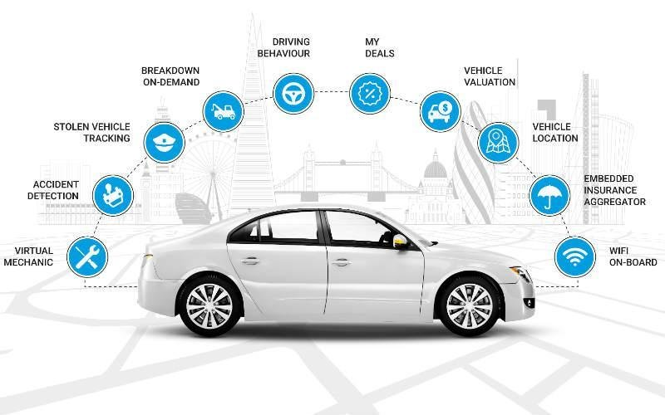
IoT Applications and Verticals- Connected Car
* https://www.researchgate.net/figure/Function-of-connected-car_fig1_323258412

Slide 46
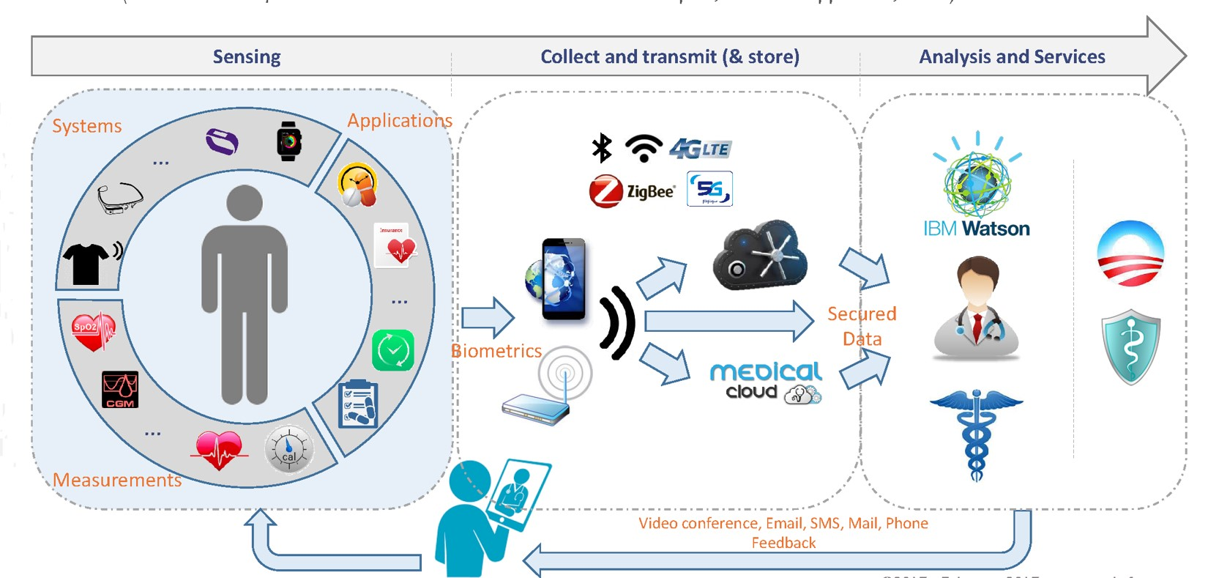
IoT Applications and Verticals- Connected Health
* http://www.yole.fr/IoT_Seminar_Yole_FraunhoferEMFT.aspx

Slide 47
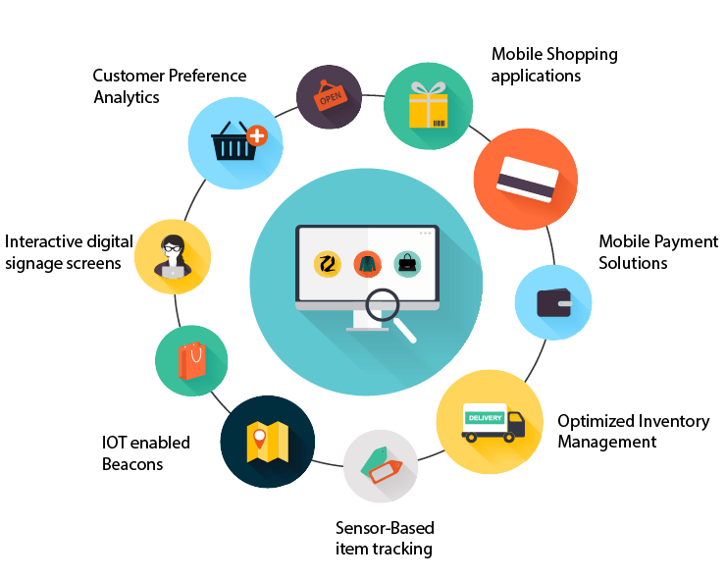
IoT Applications and Verticals- Smart Retail
* https://tmrblog.com/smart-retail-systems-market-iot-influence-the-future-of-retail-store/

Slide 48
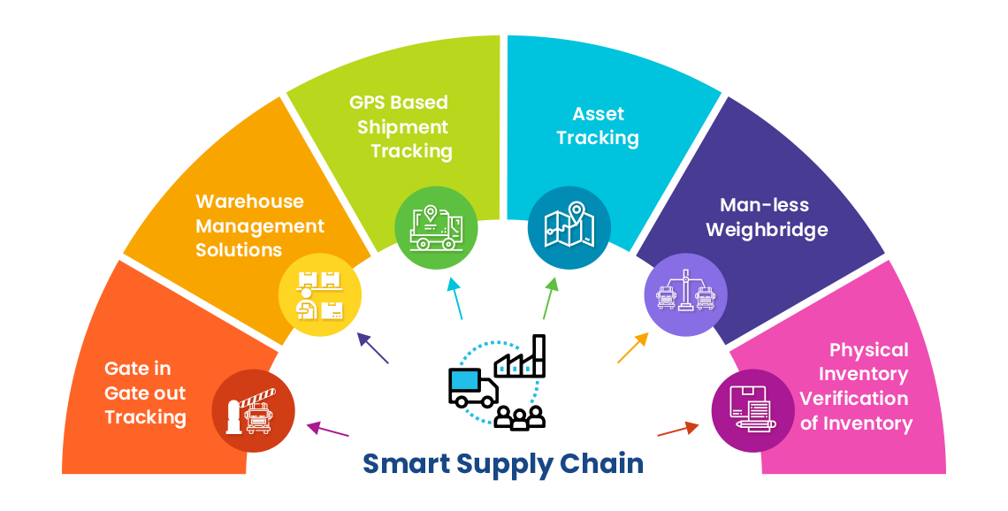
IoT Applications and Verticals- Smart Supply Chain
* https://www.ecubix.com/smart-supply-chain-solutions/

Slide 49
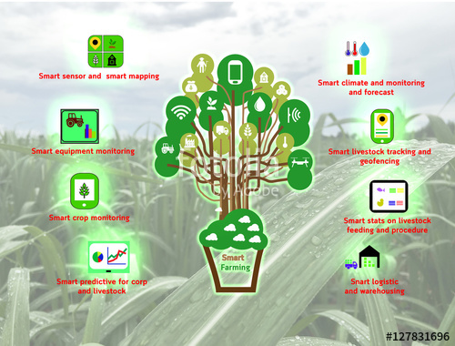
IoT Applications and Verticals- Smart Farming
* https://stock.adobe.com/images

Slide 50
Convergence of information technology (IT) and operational technology (OT)
Until recently, IT and OT have for the most part lived in separate worlds
IT supports connections to the Internet along with related data and technology systems and is focused on the secure flow of data across an organization.
OT monitors and controls devices and processes on physical operational systems. These systems include assembly lines, utility distribution networks, production facilities, roadway systems, and many more.
Notes:
In the past, OT and IT have generally been very independent
and had little need to even talk to each other. IoT is changing that paradigm.

Slide 51
Comparing OT And IT

Slide 52
Contents
Basic Concepts and History
Ecosystem
Things
Platform
Networks
Applications and Verticals
Architecture
Challenges
Business and Market Opportunities
Trends

Slide 53
IoT Challenges
Scalability
Security
Privacy
Big Data and Data Analytics
Interoperability
* IoT Fundamentals: Networking Technologies, Protocols, and Use Cases for the Internet of Thing, Cisco press, 2017

Slide 54
IoT Challenges (cont’d)
Scalability
The IPv4 address space has reached exhaustion and is unable to meet IoT’s scalability requirements.
For IoT scale can be met only by IPv6.
Security
Privacy
Big Data and Data Analytics
Interoperability
* IoT Fundamentals: Networking Technologies, Protocols, and Use Cases for the Internet of Thing, Cisco press, 2017

Slide 55
IoT Challenges (cont’d)
Scalability
Security
With more “things” connected with other “things” and people security is an increasingly complex issue for IoT.
Threat surface is greatly expanded and if device gets hacked, its connectivity is a major concern.
A Compromised device can serve as a launching point to attack other devices and systems.
Privacy
Big Data and Data Analytics
Interoperability
* IoT Fundamentals: Networking Technologies, Protocols, and Use Cases for the Internet of Thing, Cisco press, 2017

Slide 56
IoT Challenges (cont’d)
Scalability
Security
Privacy
A sensor become more prolific in every day lives, the data what they gather will be specific to individuals and their activities.
For Businesses, the data has monetary value.
Organization discusses about who owns the data and how individuals can control whether it is shared and with whom.
Big Data and Data Analytics
Interoperability
* IoT Fundamentals: Networking Technologies, Protocols, and Use Cases for the Internet of Thing, Cisco press, 2017

Slide 57
IoT Challenges (cont’d)
Scalability
Security
Privacy
Big Data and Data Analytics
IoT and large number of sensors are going to trigger deluge of data that must be handled.
This data will provide critical information and insights if it can be processed in an efficient manner.
Challenge is evaluating massive amounts of data arriving from different sources in various forms and doing so in a timely manner.
Interoperability
* IoT Fundamentals: Networking Technologies, Protocols, and Use Cases for the Internet of Thing, Cisco press, 2017

Slide 58
IoT Challenges (cont’d)
Scalability
Security
Privacy
Big Data and Data Analytics
Interoperability
As with nascent technology, various protocols and architectures are jockeying for market share and standardizations within IoT.
Some of these protocols and architectures are based on proprietary elements and others are open.
Recently IoT Standards are helping minimize this problem, but there are often various protocols and implementations available for IoT networks.
* IoT Fundamentals: Networking Technologies, Protocols, and Use Cases for the Internet of Thing, Cisco press, 2017

Slide 59
Contents
Basic Concepts and History
Ecosystem
Things
Platform
Networks
Applications and Verticals
Architecture
Challenges
Business and Market Opportunities
Products
Trends

Slide 60
IoT Architectural Drivers

Slide 61
IoT Architectural Drivers (cont.)

Slide 62
IoT Architectures
Two of the best-known architectures are those supported by
oneM2M by European Telecommunications Standards Institute (ETSI) in 2008
IoT World Forum (IoTWF) led by CISCO, IBM, and others in 2014

Slide 63
The Main Elements of the oneM2M IoT Architecture
* IoT Fundamentals: Networking Technologies, Protocols, and Use Cases for the Internet of Thing, Cisco press, 2017
Notes:
Layer 1:
At the core, modern information and communication technologies form the technical foundation of IoT.
Layer 2:
IoT generates a network of unambiguously identifiable physical objects (things). Networking, and thus also the ability to communicate, does not only refer to human participants but also to the objects (or things) involved.
These things are equipped with miniaturized processors and actuators, for example, mechanical elements, temperature controllers, and audio or video output devices that can be utilized to control the objects and the environment.
This allows for adapting objects and environments to our needs, interacting with the situation, and the provisioning of information and services according to specific situational requirements, that is, they become “smart objects” and “smart environments”.
Layer 3:
The automatic identification via RFID is often regarded as the basis for IoT. Sensors and actuators expand functionality by capturing states and the execution of actions or effects on reality.
This results in potential for new services, including consumer products as well as new business processes and business models.
Layer 4:
Products for consumers, for example, may hold and provide a large amount of information and can also offer customers with additional context-specific services during the post-sales phase.
IoT also provides a higher level of data quality for business processes, enabling organizations to respond more rapidly and properly to events, and may contribute to improved efficiency, accuracy, and economic benefits.
These potentials will lead to various product, process, and business model innovations. As these innovations affect our every day lives, they have a wide impact on individuals, society, markets, and companies.

Slide 64
The IoT World Forum (IoTWF) Standardized Architecture
* IoT Fundamentals: Networking Technologies, Protocols, and Use Cases for the Internet of Thing, Cisco press, 2017
Notes:
As shown in Figure 2-2, the IoT Reference Model defines a set of levels with
control flowing from the center (this could be either a cloud service or a
dedicated data center), to the edge, which includes sensors, devices,
machines, and other types of intelligent end nodes. In general, data travels up
the stack, originating from the edge, and goes northbound to the center.

Slide 65
Contents
Basic Concepts and History
Ecosystem
Things
Platform
Networks
Applications and Verticals
Architecture
Challenges
Business and Market Opportunities
Trends

Slide 66
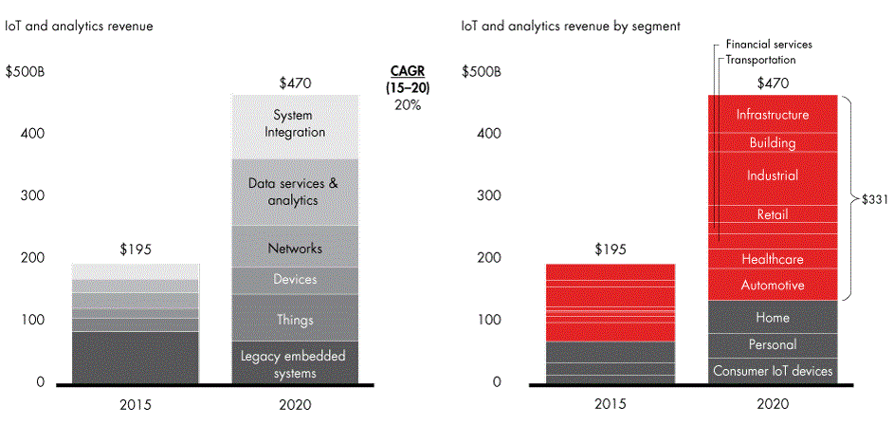
IoT Business and Market Opportunities
* https://towardsdatascience.com/internet-of-things-booming-15-trillion-market-88fde1da2113

Slide 67
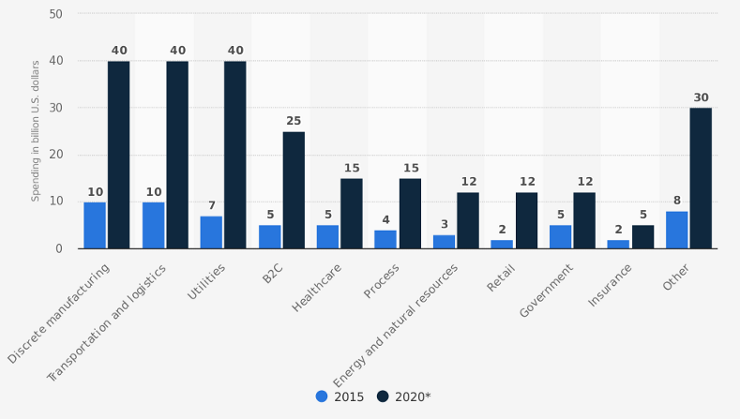
IoT Business and Market Opportunities
* https://discoperi.com/iot_devices_market/
Notes:
An American worldwide consulting agency McKinsey reports that the market of IoT can reach an annual economic impact of $3.9 trillion to $11.1 trillion by 2025 across different sectors, such as plants, smart cities, retail and rental industry, health and insurance, etc.
Such a tremendous growth in the IoT market can be explained by the increase in cloud platforms adoption and its cost-effective services (up to 35% of the annual cost).

Slide 68
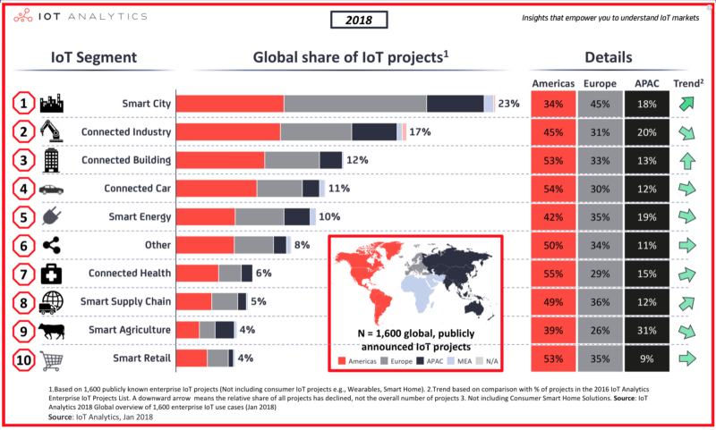
IoT Business and Market Opportunities
* https://discoperi.com/iot_devices_market/
Notes:
An American worldwide consulting agency McKinsey reports that the market of IoT can reach an annual economic impact of $3.9 trillion to $11.1 trillion by 2025 across different sectors, such as plants, smart cities, retail and rental industry, health and insurance, etc.
Such a tremendous growth in the IoT market can be explained by the increase in cloud platforms adoption and its cost-effective services (up to 35% of the annual cost).

Slide 69
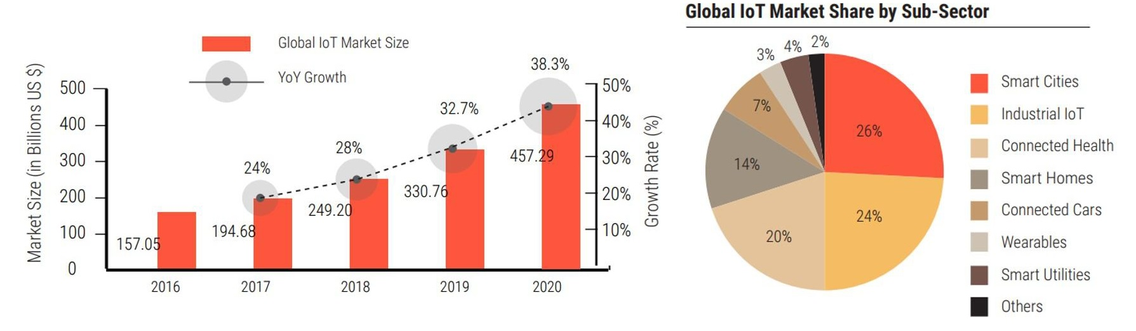
IoT Business and Market Opportunities
* https://dreamziot.com/the-upcoming-iot-market/
Notes:
With urbanization and globalization on the boom, IoT has seen a very promising growth in the market. Acting as a bridge between the physical and the digital world, Internet of Things is enabling various organizations to create a completely different experience not just for themselves but for their consumer as well. In the past couple of years, market statistics reveal that more and more organizations are willing to experiment with IoT because of their higher expectations for ROI from their large-scale initiatives. The KPIs not only indicate operational improvements, supply chain gains, better logistics but also better customer satisfaction.
Let us have a detailed insight into the revenue break up of IoT in the market and where it would stand in the coming years.”According to IDC, worldwide spending on the IoT is forecast to reach $772.5B in 2018. That represents an increase of 15% over the $674B that was spent on IoT in 2017. By the end of 2020, close to 50% of new IoT applications built by enterprises will leverage an IoT platform that offers outcome-focused functionality based on comprehensive analytics capabilities.
The global IoT market will grow from $157B in 2016 to $457B by 2020, attaining a Compound Annual Growth Rate (CAGR) of 28.5%. Discrete Manufacturing, Transportation and Logistics, and Utilities will lead all industries in IoT spending by 2020, averaging $40B each.”

Slide 70
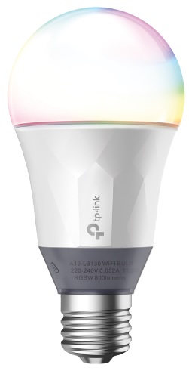
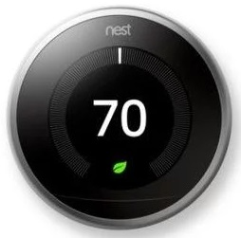
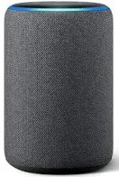
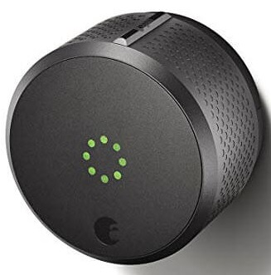
IoT- Products
Kasa Smart Wi-Fi LED Bulb with Multicolour
$29.99
All-new Echo (3rd Gen)- Smart speaker with Alexa
$89.99
August Smart Lock
$ 220
Google Nest Learning Thermostat
$249
Notes:
Kasa Smart Wi-Fi LED Bulb with Multicolour
No Hub Required – Connect the bulb directly to your Wi-Fi at home
Manage Remotely – Easy setup and control from anywhere with the free Kasa app (iOS, Android)
Colour Changing – Fine-tune colours for every occasion and adjust brightness as well as light appearance from soft white (2500k) to daylight (9000k)
Voice Control – Pair to Amazon Alexa and the Google Assistant to enable voice control
Circadian Mode – Dynamically adjust light intensity and temperature to mimic natural light patterns
Save Energy – Reduce energy use up to 80% without brightness or quality loss compared to a 60W incandescent bulb
Compatibility – Compatible with Android, iOS and Amazon Alexa and the Google Assistant
Google Nest Learning Thermostat
Since 2011, Nest thermostats have saved about 49 KWh of energy. The Nest Learning Thermostat is the first thermostat to get ENERGY STAR certified. It learns what temperature you like and builds a schedule around yours. Since 2011, the Nest Thermostat has saved billions of kWh of energy in millions of homes worldwide.* And independent studies showed that it saved people an average of 10% to 12% on heating bills and 15% on cooling bills. So in under two years, it can pay for itself. The Nest Learning Thermostat automatically adapts as your life and the seasons change. Just use it for a week and it programs itself. Nest shows you how much energy you use every day in Energy History and every month in your Home Report. So you can see when you use more energy, like on weekends or Monday nights, and how to use less. With the Nest app, your thermostat lives on your wall and in your pocket. Once you connect your thermostat to Wi-Fi, you can control it from anywhere. Adjust the temperature from the app, and the Nest Thermostat adjusts quickly back at home. The Nest Thermostat is just one part of your heating and cooling system. But it can keep an eye on the rest of it. You’ll get an alert on your phone if there’s something wrong — like temperatures are so low your pipes could burst. And if it looks like your furnace is acting up, the Nest Thermostat will send you an alert.
All-new Echo (3rd Gen)- Smart speaker with Alexa
Voice control your music - Ask Alexa for a song, artist, or genre from Amazon Music, Apple Music, Spotify, Pandora, SiriusXM, and more. With multi-room music, play music on compatible Echo devices in different rooms.
Voice control your smart home - Turn on lights, adjust thermostats, lock doors, and more with compatible connected devices.
Keep your family in sync - Use your Alexa devices like an intercom and talk to any room in the house with Drop In and Announcements.
Alexa has skills - With tens of thousands of skills and counting, Alexa is always getting smarter and adding new skills like tracking fitness, playing games, and more.
Designed to protect your privacy - Built with multiple layers of privacy controls, including a microphone off button that electronically disconnects the mics.
Make your life easier at home. Use your voice to set timers, add items to lists and create calendar events and reminders. You can also check the news, weather or traffic. Ask for sports scores, film screening times or information. For example: “Alexa, add ‘learn to cook’ to my to do list”.
Manage compatible smart home devices using your voice. Switch on the lamp before getting out of bed, turn on the coffee machine on your way to the kitchen, or dim the lights from the sofa to watch a film.
Make hands-free calls to almost anyone including UK mobile and residential numbers (from UK only, emergency calling not supported), other Echo devices and the Alexa app. You can also link Alexa with your mobile phone account to ask Alexa to make and answer your mobile calls (Vodafone UK). Use Announcements to send voice messages to every room with an Echo device, or use Drop In as a two-way intercom between rooms. For example: “Alexa, call mom”.
August Smart Lock
August Smart Lock has proven to be a reliable security IoT device. It allows the user to manage their doors from any location hassle-free. It helps the user to keep thieves away and family in your home.
Allows the user to know about each and every person coming and going into your home.
Provides unlimited digital keys and no fear of stolen key.
It gives the status updates of your door as it is properly closed or not.
It has a good auto-unlock feature and as soon as the user arrives near the door it opens automatically.
Easy installation and is compatible with most standard single cylinder deadbolts.

Slide 71

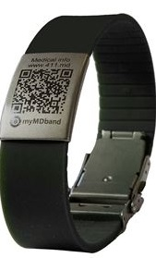
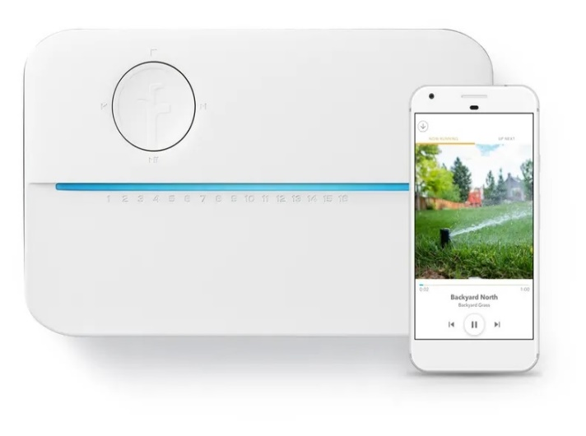
IoT- Products
Rachio 3, Smart Sprinkler Controller
$229.99
MyMDband, Medical Bracelet
$99.99
Aladin home, A magic lamp designed for comfort at home
49,50 €/month

Slide 72
Contents
Basic Concepts and History
Ecosystem
Things
Platform
Networks
Applications and Verticals
Architecture
Challenges
Business and Market Opportunities
Trends

Slide 73
IoT Trends
Artificial Intelligence
Social, Legal, and Ethical IoT
Infonomics and Data Broking
The Shift from Intelligent Edge to Intelligent Mesh
IoT Governance
Sensor Innovation
Trusted Hardware and Operating System
Novel IoT User Experiences
Silicon Chip Innovation
New Wireless Networking Technologies for IoT
* https://www.gartner.com/en/newsroom/press-releases/2018-11-07-gartner-identifies-top-10-strategic-iot-technologies-and-trends
Notes:
Trend No. 1: Artificial Intelligence (AI)
Gartner forecasts that 14.2 billion connected things will be in use in 2019, and that the total will reach 25 billion by 2021, producing immense volume of data. “Data is the fuel that powers the IoT and the organization’s ability to derive meaning from it will define their long term success,” said Mr. Jones. “AI will be applied to a wide range of IoT information, including video, still images, speech, network traffic activity and sensor data.”
The technology landscape for AI is complex and will remain so through 2023, with many IT vendors investing heavily in AI, variants of AI coexisting, and new AI-based tolls and services emerging. Despite this complexity, it will be possible to achieve good results with AI in a wide range of IoT situations. As a result, CIOs must build an organization with the tools and skills to exploit AI in their IoT strategy.
Trend No. 2: Social, Legal and Ethical IoT
As the IoT matures and becomes more widely deployed, a wide range of social, legal and ethical issues will grow in importance. These include ownership of data and the deductions made from it; algorithmic bias; privacy; and compliance with regulations such as the General Data Protection Regulation.
“Successful deployment of an IoT solution demands that it’s not just technically effective but also socially acceptable,” said Mr. Jones. “CIOs must, therefore, educate themselves and their staff in this area, and consider forming groups, such as ethics councils, to review corporate strategy. CIOs should also consider having key algorithms and AI systems reviewed by external consultancies to identify potential bias.”
Trend No. 3: Infonomics and Data Broking
Last year’s Gartner survey of IoT projects showed 35 percent of respondents were selling or planning to sell data collected by their products and services. The theory of infonomics takes this monetization of data further by seeing it as a strategic business asset to be recorded in the company accounts. By 2023, the buying and selling of IoT data will become an essential part of many IoT systems. CIOs must educate their organizations on the risks and opportunities related to data broking in order to set the IT policies required in this area and to advise other parts of the organization.
Trend No. 4: The Shift from Intelligent Edge to Intelligent Mesh
The shift from centralized and cloud to edge architectures is well under way in the IoT space. However, this is not the end point because the neat set of layers associated with edge architecture will evolve to a more unstructured architecture comprising of a wide range of “things” and services connected in a dynamic mesh. These mesh architectures will enable more flexible, intelligent and responsive IoT systems — although often at the cost of additional complexities. CIOs must prepare for mesh architectures’ impact on IT infrastructure, skills and sourcing.
Trend No. 5: IoT Governance
As the IoT continues to expand, the need for a governance framework that ensures appropriate behavior in the creation, storage, use and deletion of information related to IoT projects will become increasingly important. Governance ranges from simple technical tasks such as device audits and firmware updates to more complex issues such as the control of devices and the usage of the information they generate. CIOs must take on the role of educating their organizations on governance issues and in some cases invest in staff and technologies to tackle governance.
Trend No. 6: Sensor Innovation
The sensor market will evolve continuously through 2023. New sensors will enable a wider range of situations and events to be detected, current sensors will fall in price to become more affordable or will be packaged in new ways to support new applications, and new algorithms will emerge to deduce more information from current sensor technologies. CIOs should ensure their teams are monitoring sensor innovations to identify those that might assist new opportunities and business innovation.
Trend No. 7: Trusted Hardware and Operating System
Gartner surveys invariably show that security is the most significant area of technical concern for organizations deploying IoT systems. This is because organizations often don’t have control over the source and nature of the software and hardware being utilised in IoT initiatives. “However, by 2023, we expect to see the deployment of hardware and software combinations that together create more trustworthy and secure IoT systems,” said Mr. Jones. “We advise CIOs to collaborate with chief information security officers to ensure the right staff are involved in reviewing any decisions that involve purchasing IoT devices and embedded operating systems.”
Trend 8: Novel IoT User Experiences
The IoT user experience (UX) covers a wide range of technologies and design techniques. It will be driven by four factors: new sensors, new algorithms, new experience architectures and context, and socially aware experiences. With an increasing number of interactions occurring with things that don’t have screens and keyboards, organizations’ UX designers will be required to use new technologies and adopt new perspectives if they want to create a superior UX that reduces friction, locks in users, and encourages usage and retention.
Trend No. 9: Silicon Chip Innovation
“Currently, most IoT endpoint devices use conventional processor chips, with low-power ARM architectures being particularly popular. However, traditional instruction sets and memory architectures aren’t well-suited to all the tasks that endpoints need to perform,” said Mr. Jones. “For example, the performance of deep neural networks (DNNs) is often limited by memory bandwidth, rather than processing power.”
By 2023, it’s expected that new special-purpose chips will reduce the power consumption required to run a DNN, enabling new edge architectures and embedded DNN functions in low-power IoT endpoints. This will support new capabilities such as data analytics integrated with sensors, and speech recognition included in low cost battery-powered devices. CIOs are advised to take note of this trend as silicon chips enabling functions such as embedded AI will in turn enable organizations to create highly innovative products and services.
Trend No. 10: New Wireless Networking Technologies for IoT
IoT networking involves balancing a set of competing requirements, such as endpoint cost, power consumption, bandwidth, latency, connection density, operating cost, quality of service, and range. No single networking technology optimizes all of these and new IoT networking technologies will provide CIOs with additional choice and flexibility. In particular they should explore 5G, the forthcoming generation of low earth orbit satellites, and backscatter networks

Slide 74
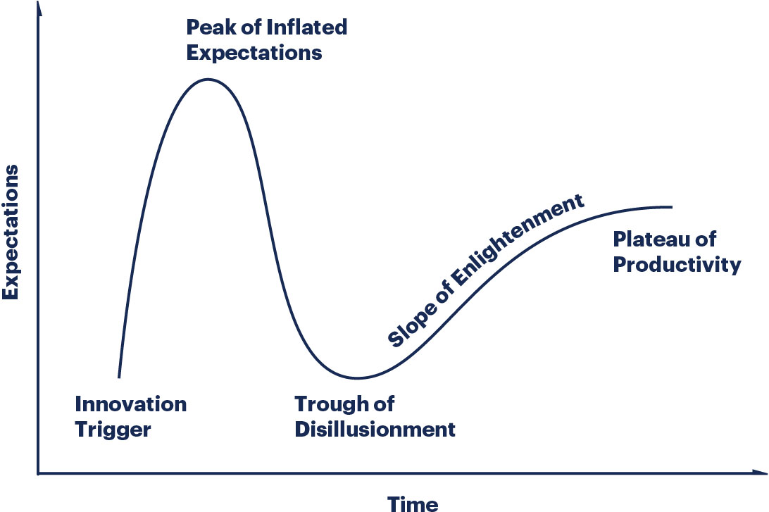
IoT Trends
*https://www.gartner.com/en/research/methodologies/gartner-hype-cycle

Slide 75
Hype Cycle: five key phases of a technology’s life cycle.
Innovation Trigger: A potential technology breakthrough kicks things off. Early proof-of-concept stories and media interest trigger significant publicity. Often no usable products exist and commercial viability is unproven.
Peak of Inflated Expectations: Early publicity produces a number of success stories — often accompanied by scores of failures. Some companies take action; many do not.
Trough of Disillusionment: Interest wanes as experiments and implementations fail to deliver. Producers of the technology shake out or fail. Investments continue only if the surviving providers improve their products to the satisfaction of early adopters.
Slope of Enlightenment: More instances of how the technology can benefit the enterprise start to crystallize and become more widely understood. Second- and third-generation products appear from technology providers. More enterprises fund pilots; conservative companies remain cautious.
Plateau of Productivity: Mainstream adoption starts to take off. Criteria for assessing provider viability are more clearly defined. The technology's broad market applicability and relevance are clearly paying off.
*https://www.gartner.com/en/research/methodologies/gartner-hype-cycle

Slide 76
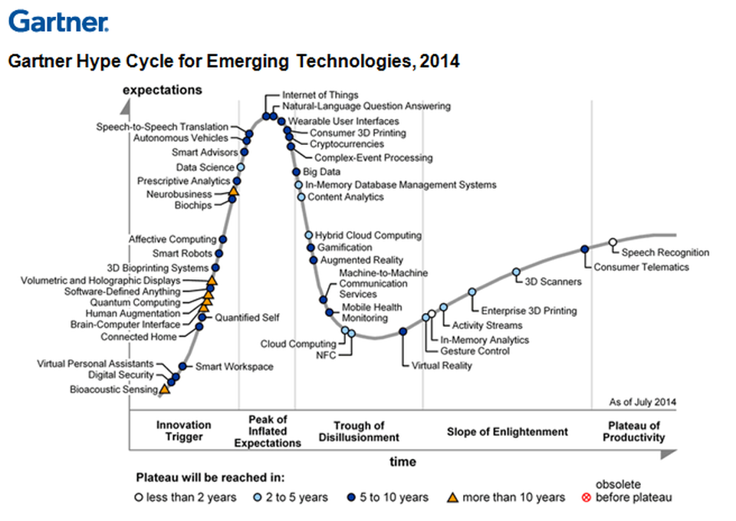
IoT Trends
* https://gartner.com
Notes:
What is Gartner hype curve?
Gartner's Hype Cycle is a graphical depiction of a common pattern that arises with each new technology or other innovation. ... The five phases in the Hype Cycle are Technology Trigger, Peak of Inflated Expectations, Trough of Disillusionment, Slope of Enlightenment and Plateau of Productivity.

Slide 77
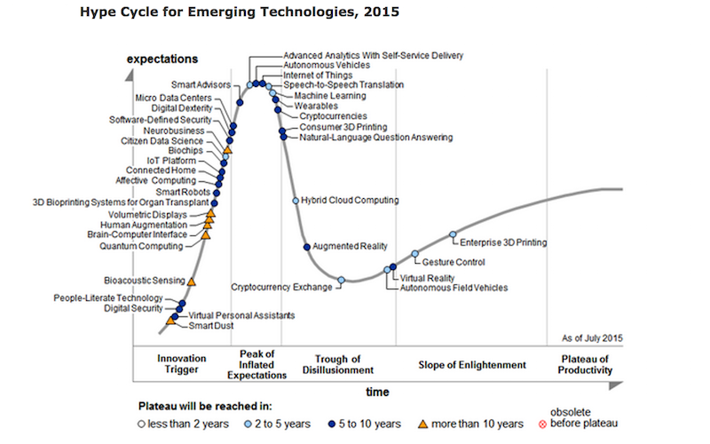
IoT Trends
* https://gartner.com

Slide 78
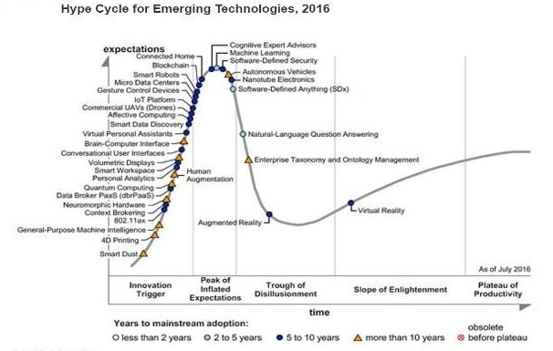
IoT Trends
* https://gartner.com

Slide 79
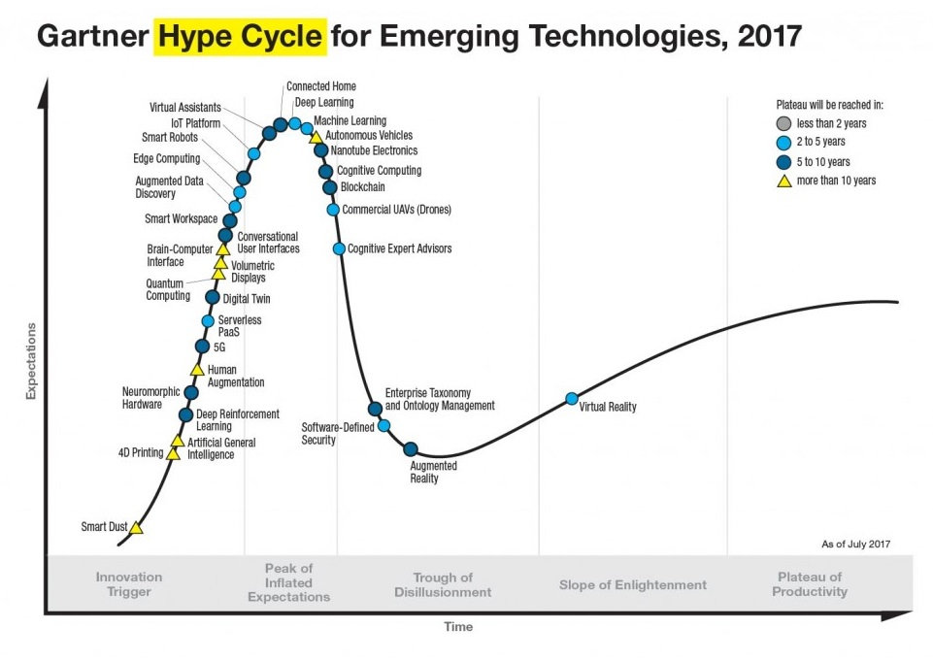
IoT Trends
* https://gartner.com

Slide 80
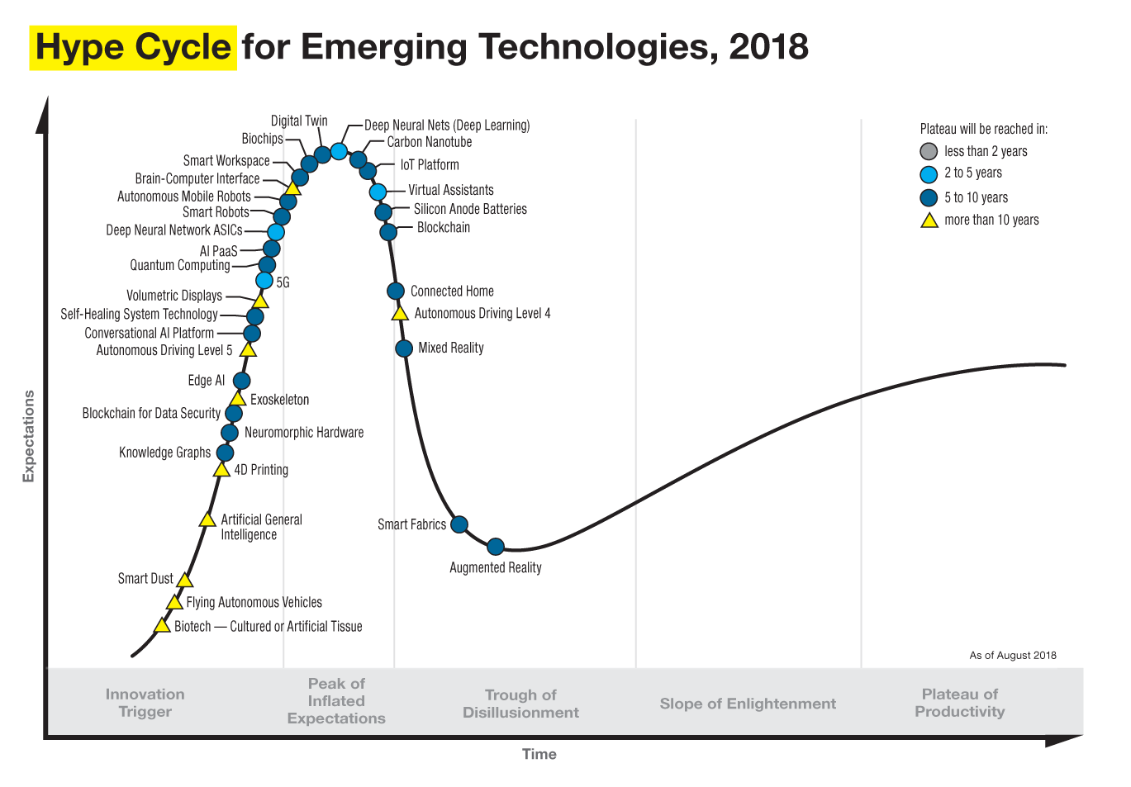
IoT Trends
* https://gartner.com

Slide 81
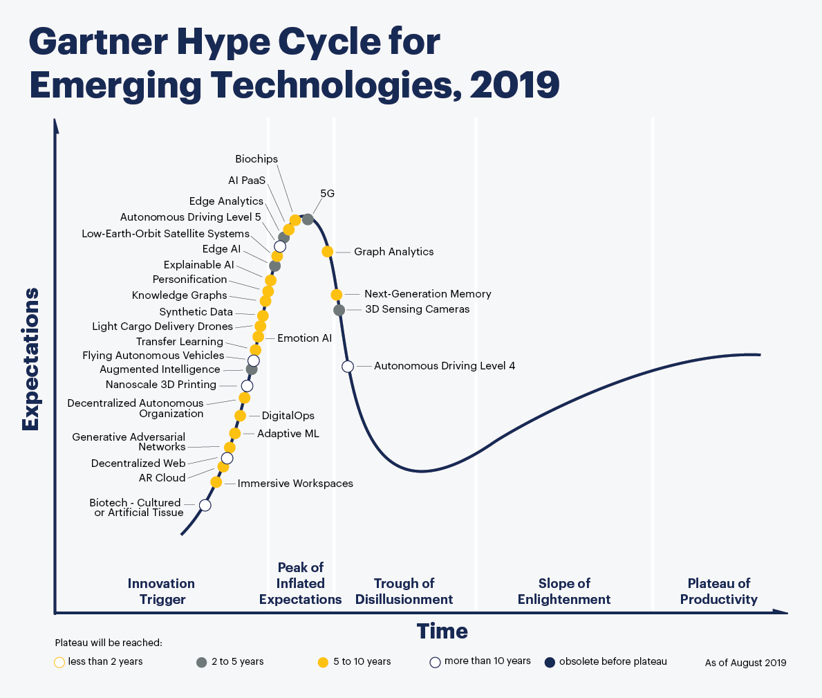
IoT Trends
* https://gartner.com
Notes:
why does not gartner hype cycle 2019 include iot?
Edge AI – Edge AI refers to the use of AI techniques embedded in IoT endpoints, gateways, and edge devices, in applications ranging from autonomous vehicles to streaming analytics. (https://www.enterpriseirregulars.com/144131/whats-new-in-gartners-hype-cycle-for-ai-2019/)

Slide 82
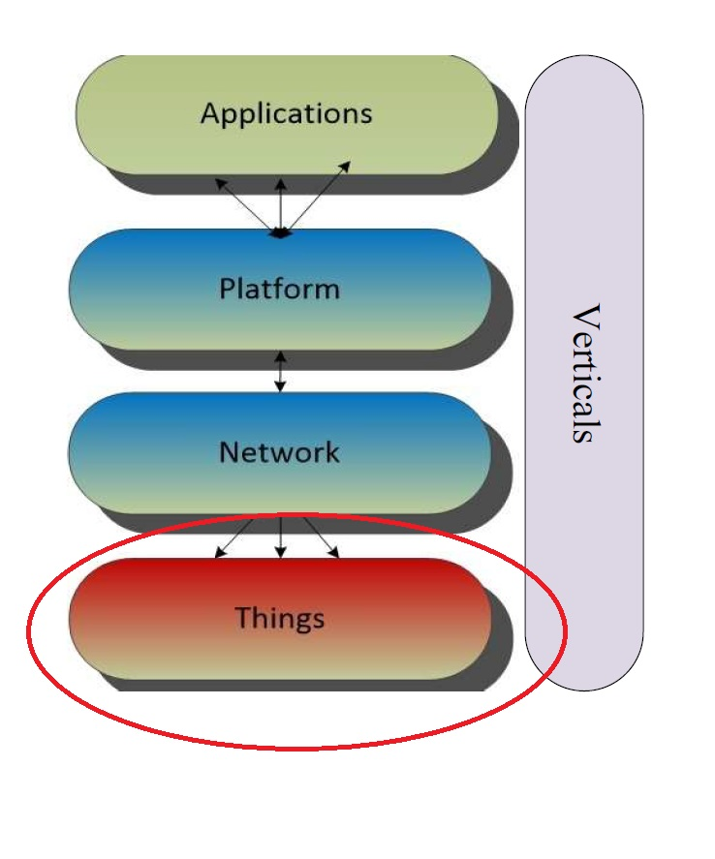
Next Lecture
An overview of
Electronic
Microcontrollers
Things (sensors and actuators)
gateways

